Slide 1

GA Project 1: Standardized Test Analysis
SAT vs ACT tests
Kwek Jun Hong, GA DSI 26

Slide 2
Background
The SAT and ACT are standardized tests that many colleges and universities in the United States require for their admissions process.
The SAT has two sections of the test: Evidence-Based Reading and Writing and Math. SAT score range is between 400 to 1600.
The ACT has 4 sections: English, Mathematics, Reading, and Science, with an additional optional writing section. ACT score range is between 1 to 36.

Slide 3
Problem Statement
In this project, I will be examining and exploring:
The trends in SAT and ACT participation rates and the aggregate scores in 2017, 2018 and 2019.
The trends in the SAT scores and number of test takers for the intended majors in 2017, 2018 and 2019.
Objectives:
To identify trends and patterns to propose recommendations to College Board for the states to target to improve SAT participation rates.

Slide 4
Executive Summary (Analysis)
The trends analyzed includes:
A test with high participation rate for one test will usually mean a low participation rate for the other test. Hence, those states with mandatory ACT testing should not be targeted to improve SAT participation rates.
Test scores and participation rates of the tests stayed largely similar between the years of 2017 to 2019.
The test scores for a test are negatively correlated with the participation rates of the test. The SAT test scores for an intended major and number test takers stayed largely similar between the years of 2017 to 2019.
There is almost no correlation between the number of test takers and the SAT scores for an intended major in the same year.

Slide 5
Executive Summary (Recommendations)
The recommendations would be to target California and Virginia for the states to improve SAT participation rates.
due to no mandatory testing policy, high population density and large population to increase the effectiveness and efficiency of the measures taken.
Proposed measures that can be implemented include reducing the cost of SAT test and providing access to study and practice resources for potential students.

Slide 6
Methodology taken
Data Import and Cleaning
Checking for missing values in the dataframe, minimum and maximum values to ensure values are within the range of the respective tests.
To identify any odd values and clean the datasets
Converting the percentage values of participation rates to decimal values
Checking the data types to ensure that the data align correctly with the data types.
Exploratory Data Analysis (EDA)
Checking of summary statistics for the dataset and to identify certain trends via sorting within certain ranges and finding the minimums and maximums.
Data Visualization
Plotting of the charts (histograms, scatter plots, box plots and bar charts) to further explain and illustrate the EDA insights gathered in the previous sections.

Slide 7
Findings for SAT and ACT scores
Test scores and participation rates of the tests stayed largely similar between the years of 2017 to 2019 where the states that score well will continue to score well in the following years.
The strong positive correlation is illustrated in the scatter plots of SAT and ACT scores year on year where the scores in the previous year is strongly correlated with the next year for both SAT and ACT.
This relationship is also demonstrated for the SAT and ACT participation rates year on year.

Slide 8
Findings for SAT and ACT scores
Test scores and participation rates of the tests stayed largely similar between the years of 2017 to 2019 where the states that score well will continue to score well in the following years.
The strong positive correlation is illustrated in the scatter plots of SAT and ACT scores year on year where the scores in the previous year is strongly correlated with the next year for both SAT and ACT.
This relationship is also demonstrated for the SAT and ACT participation rates year on year.

Slide 9
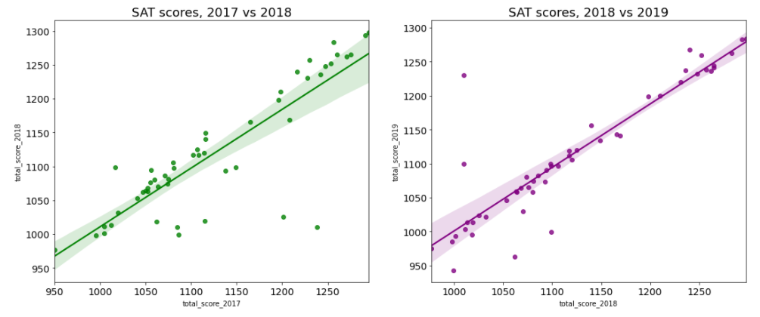
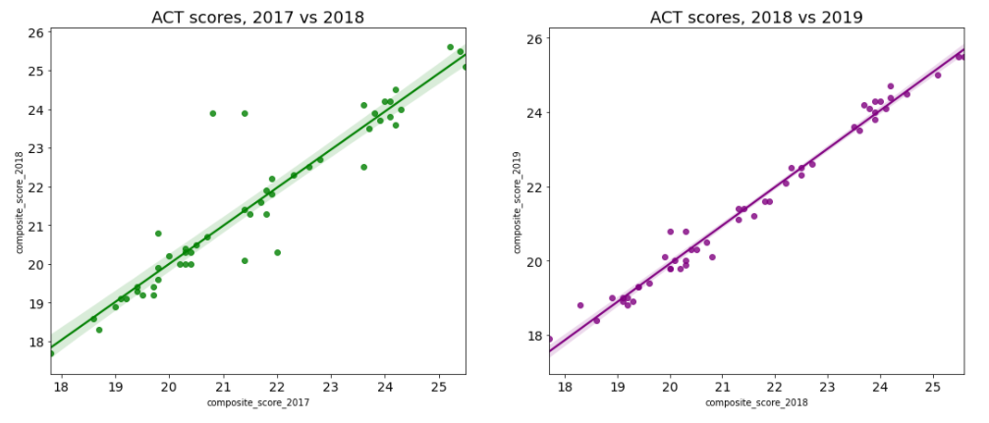
Scatter Plots
SAT scores for 2017 vs 2018 and 2018 vs 2019
ACT scores for 2017 vs 2018 and 2018 vs 2019

Slide 10
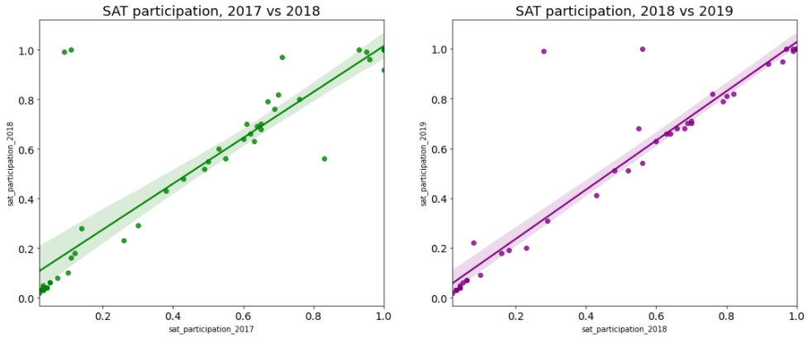
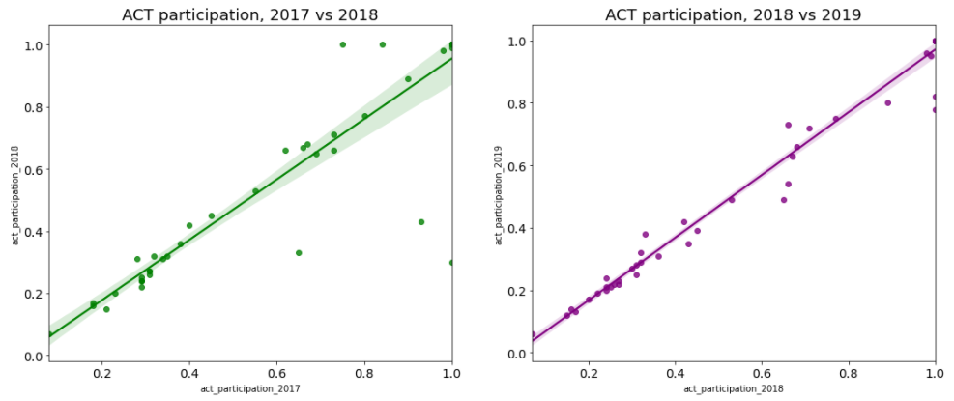
Scatter Plots for SAT and ACT participation (YoY)
SAT participation for 2017 vs 2018 and 2018 vs 2019
ACT participation for 2017 vs 2018 and 2018 vs 2019

Slide 11
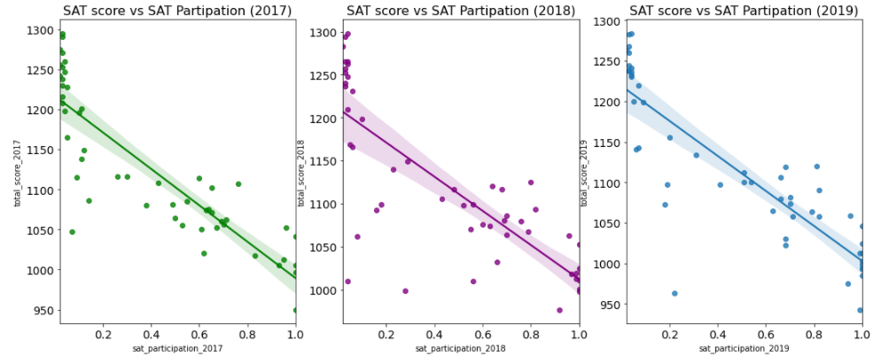
Findings
The test scores for a test are negatively correlated with the participation rates of the test.
Hence, with a larger participation rate, it should result in a lower test score for that test.
SAT score vs SAT participation scatter plot

Slide 12
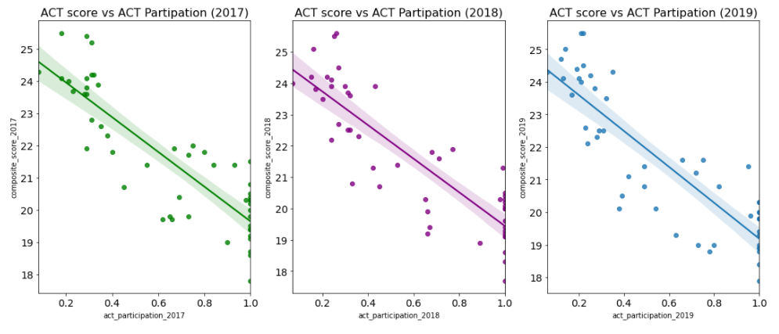
Scatter Plots for ACT scores vs ACT Participation
ACT score vs ACT participation scatter plot

Slide 13
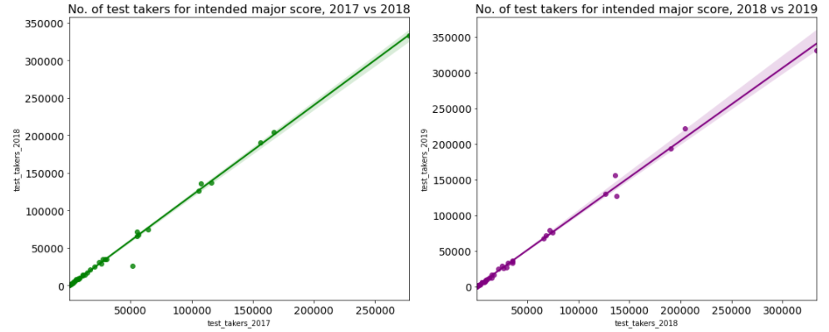
Findings for SAT scores and test takers for intended majors
There is an almost perfect positive correlation for the number of test takers on a year-on-year basis.
Test takers for intended majors 2017 vs 2018, 2018 vs 2019 scatter plot

Slide 14
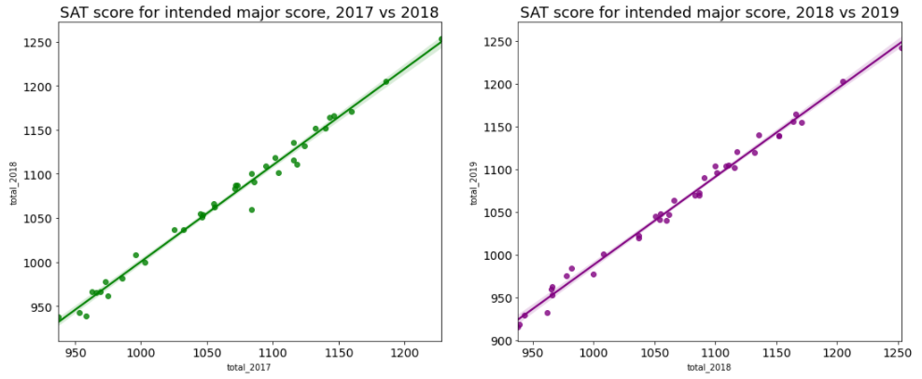
Findings for SAT scores and test takers for intended majors
There is an almost perfect positive correlation for the mean total scores on a year-on-year basis.
Scores for intended majors 2017 vs 2018, 2018 vs 2019 scatter plot

Slide 15
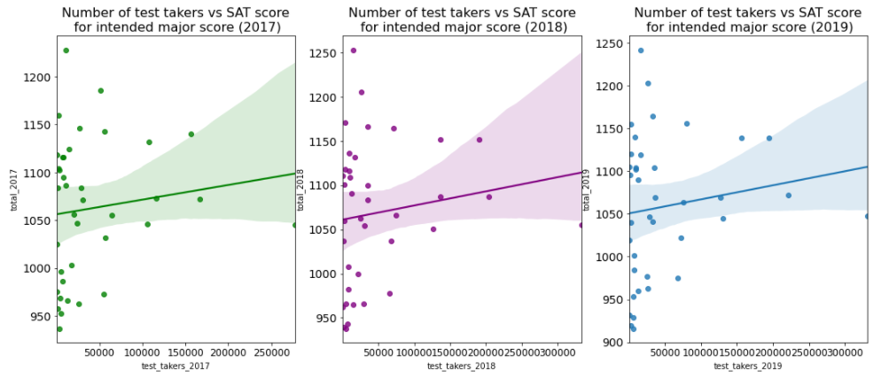
Findings for SAT scores and test takers for intended majors
There is almost no correlation relationship between the number of test takers to the mean score for that intended major.
Scores vs test takers for intended majors scatter plot

Slide 16
Findings for Analysis of SAT vs ACT participation for each state
From the side-by-side analysis of the states of the participation rates of SAT and ACT tests would help to identify which states would be a good choice to focus on to improve the SAT participation rates.
These states have been filtered to exclude the states that have mandatory testing for ACT and SAT.

Slide 17
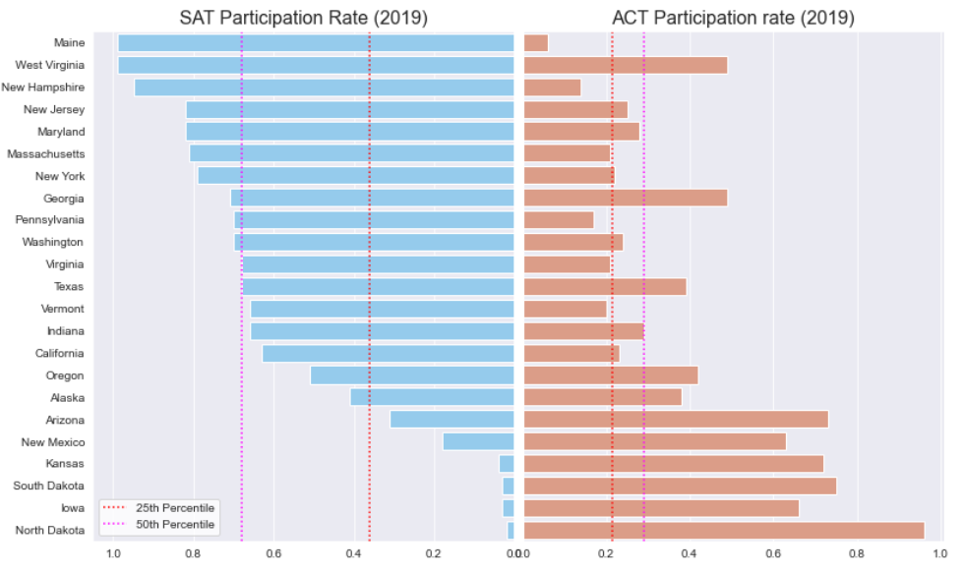
Findings
The recommended states where resources can be focused to improve SAT participation rates would be California and Virginia as highlighted above in yellow.

Slide 18
Findings
California and Virginia are the recommended states due to:
There are no mandatory requirement for college aptitude testing for these states.
These two states have low SAT participation rates among the states which are below the 50th percentile in 2017 to 2019.
The two states have a high population density ranking 12th for California and 23rd for Virginia among U.S. Federal States.
In addition, California has the largest population while Virginia has the 13th largest population in U.S.
The population size and density will help to increase the effectiveness and efficiency of the deployed resources in these states to improve the participation rates.

Slide 19
Key Takeaways
For the SAT and ACT scores and participation rates
Test scores and participation rates of the tests stayed largely similar between the years of 2017 to 2019 where the states that score well will continue to score well in the following years.
For a test with high participation rate for one test will usually mean a low participation rate for the other test.
The test scores for a test are negatively correlated with the participation rates of the test.
For the SAT scores and test takers for intended majors
The SAT test scores for an intended major and number test takers stayed largely similar between the years of 2017 to 2019.
There is almost no correlation between the number of test takers and the SAT scores for an intended major in the same year.

Slide 20
Recommendations to College Board
Recommended states to allocate resources to improve SAT participation rates would be California and Virginia.
Possible measures to increase participation rates:
Reduction of the cost to take the SAT tests:
Currently, the cost to take the SAT test (USD 52) is very similar to ACT test (USD 55) to attract students to choose SAT instead of ACT.
Increasing the number of fee waivers and to make the eligibility requirements for the fee wavier more lenient.
SAT Study and practice resources:
Providing easy access to these resources for student to access.
These resources can be provided at school and public libraries as well as online for student to access and ideally for free.

Slide 21
Recommended measures to College Board
Reduction of the cost to take the SAT tests.
Currently, the cost to take the SAT test (USD 52) is very similar to ACT test (USD 55) to attract students to choose SAT instead of ACT.
Increasing the number of fee waivers and to make the eligibility requirements for the fee wavier more lenient.
SAT Study and practice resources
Providing easy access to these resources for student to access.
These resources can be provided at school and public libraries as well as online for student to access and ideally for free.

Slide 22
The End

